Slide 1
Employee Data Analysis using Excel
STUDENT NAME: S. Srigayathri
REGISTER NO: 312205365, FADEB1BE7D1A232B5F743A7954072
DEPARTMENT: B.COM (Accounting & Finance)
COLLEGE: Valliammal College for Women

Slide 2
PROJECT TITLE
Employment Data Analytics Using Excel Techniques
+

Slide 3


AGENDA
Problem Statement
Project Overview
End Users
Our Solution and Proposition
Dataset Description
Modelling Approach
Results and Discussion
Conclusion
3/21/2024 Annual Review

Slide 4

PROBLEM STATEMENT
Utilize Excel to efficiently analyse employee data by leveraging functions such as PivotTables, and conditional formatting. This enables the identification of key trends, such as current employee rates, performance levels. Decision-making processes by visualizing this data through pie chart.”

Slide 5

PROJECT OVERVIEW
To Provide an Employee data analysis summary,
I”II need to outline a few common problem statement and how they can be addressed through analysis. Below are example of potential problem statement and the corresponding analyses that might be conducted:
Employee Engagement and Productivity
Workforce Diversity and Inclusion
Skill Gap Analysis
Compensation and Benefits Optimization
Improving Employee Retention through Career Development
High Employee Turnover Rate
Workforce Planning and Optimization.

Slide 6
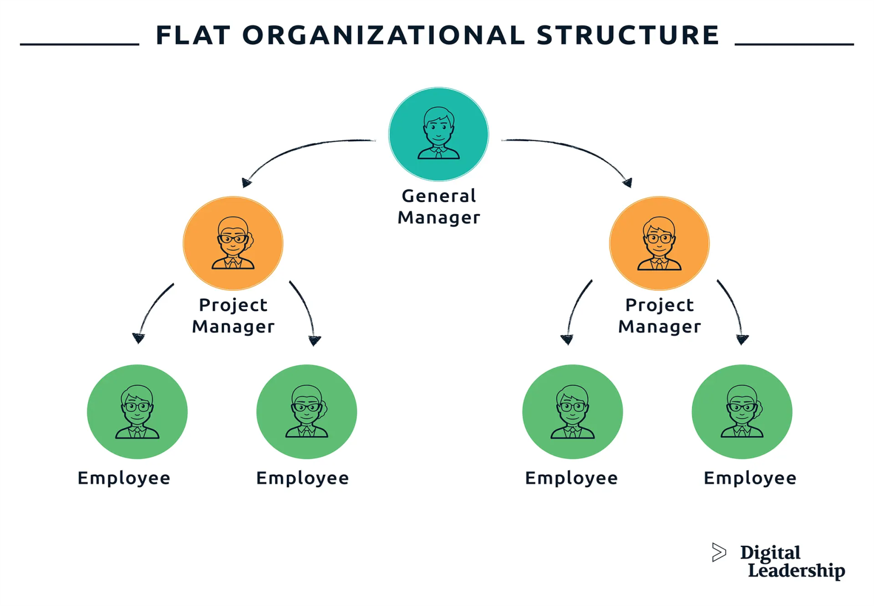

WHO ARE THE END USERS?

Slide 7

OUR SOLUTION AND ITS VALUE PROPOSITION
Conditional formatting – highlights missing cells Filter- helps to remove the empty cells Formula – helps to identify the performance of employees Pivot table – helps to summarise Pie chart – shows the data

Slide 8
Dataset Description
This description is about employee data analysis which is done through kaggle. It has 26 total features and in this data set it has involved 6 feature which includes;
Employee ID
Name
Gender
Department
Salary
Employee Type.

Slide 9

THE "WOW" IN OUR SOLUTION
PERFORMANCE LEVEL= IFS(Z8>=5, “VERY HIGH”, Z8>=4, “HIGH”,Z8>=3,”MED”,TRUE,” LOW”)
3/21/2024 Annual Review
9

Slide 10
MODELLING
DATA COLLECTION Identification Gathering Preparation DATA CLEANING
Standardization Correction Validation SUMMARY
Data analysis involves examining, transforming, and modeling data to extract meaningful insights, identify patterns, and support decision-making.
10

Slide 11
RESULTS
11

Slide 12
conclusion
The employee data analysis was conducted to evaluate various aspects of the workforce , including demographics, performance metrics, turnover rates, and employee satisfaction . The primary goals were to identify trends, potential areas for improvement, and to develop actionable insights to enhance organizational effectiveness.

